Slide 1

SC1007 Data Structure and Algorithms Tutorial Session 3 Binary Trees

Slide 2


Slides and Source-code
Slides
https://nextcloud.broderlands.com/s/DcEMamAczQbkYxJ
Source code
https://git.broderlands.com/explore/repos

Slide 3
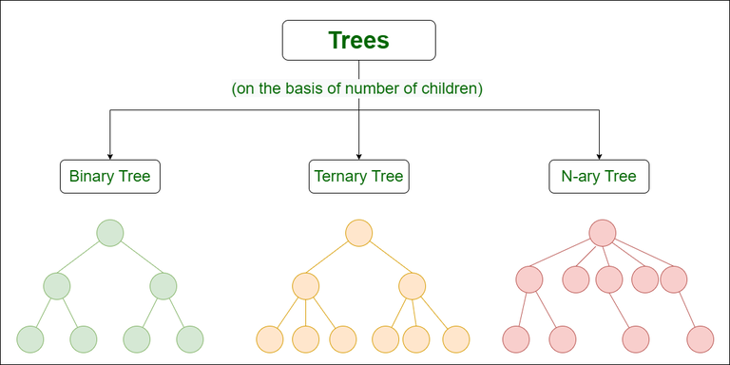
Type of Trees
Image Source: geeksforgeeks.org

Slide 4
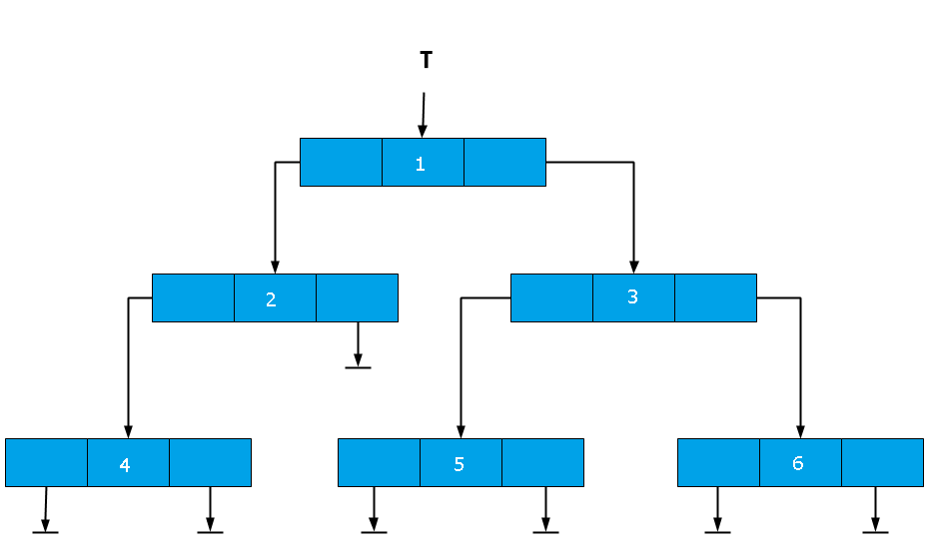
Binary Tree
BT operations:
insert(root, item) : add a new item to the tree while maintaining its BST properties
delete(root, item) : delete an item at index while maintaining its BST properties
search(root, item) : find a node with a given value
Traverse:
preorder() : Traversal in order root -> left -> right
inorder() : Traversal in order left -> root -> right
postorder() : Traversal in order left -> right -> root
levelorder() : Traversal level by level using a queue
max_depth() : returns the max depth

Slide 5
Binary Tree
Usage:
Binary Tree Search (BST) : efficient searching, insertion and deletion
Heaps
Huffman Coding tree : Data compression
AVL Trees : Self-balancing BSTs
B-Trees : Balanced storage for databases
Decision Trees : Machine Learning

Slide 6
Question 1

Slide 7
Question 1
pre-order: A, B, C, D, E, F, G
inorder: C, B, E, D, A, F, G

Slide 8
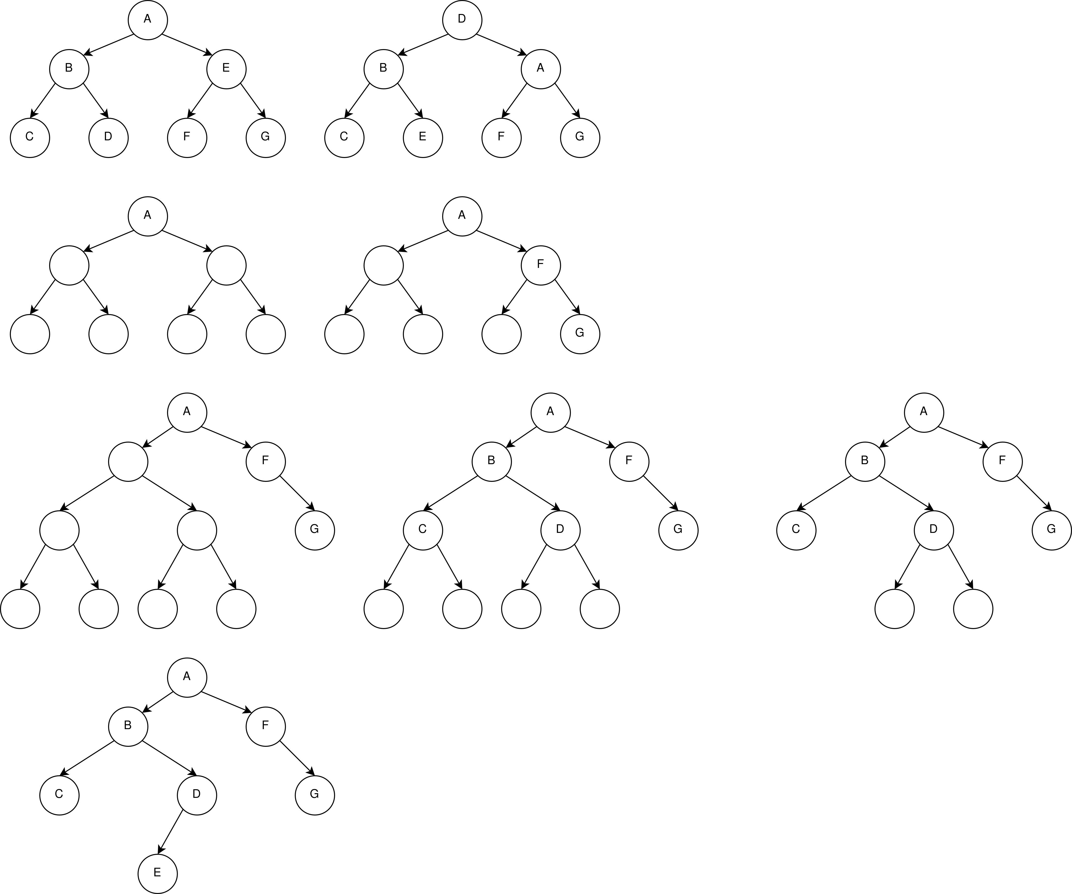
Question 1
pre-order: A, B, C, D, E, F, G
inorder: C, B, E, D, A, F, G

Slide 9
Question 1
pre-order: A, B, C, D, E, F, G
inorder: C, B, E, D, A, F, G

Slide 10
Question 1
pre-order: A, B, C, D, E, F, G
inorder: C, B, E, D, A, F, G

Slide 11
Question 1
pre-order: A, B, C, D, E, F, G
inorder: C, B, E, D, A, F, G

Slide 12
Question 1
pre-order: A, B, C, D, E, F, G
inorder: C, B, E, D, A, F, G

Slide 13
Question 1
pre-order: A, B, C, D, E, F, G
inorder: C, B, E, D, A, F, G

Slide 14
Question 1
pre-order: A, B, C, D, E, F, G
inorder: C, B, E, D, A, F, G

Slide 15
Question 1
pre-order: A, B, C, D, E, F, G
inorder: C, B, E, D, A, F, G

Slide 16
Question 2

Slide 17
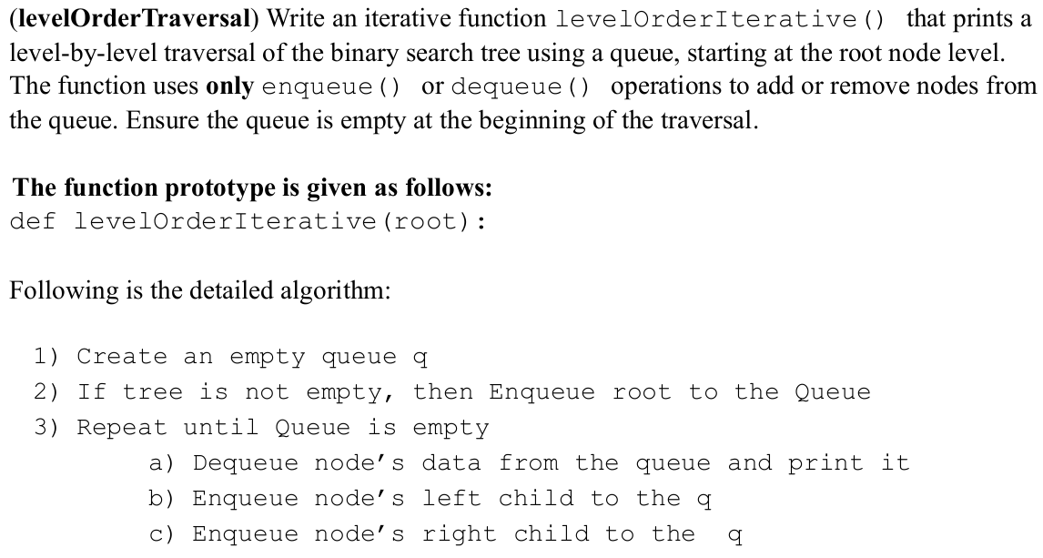
Question 2

Slide 18
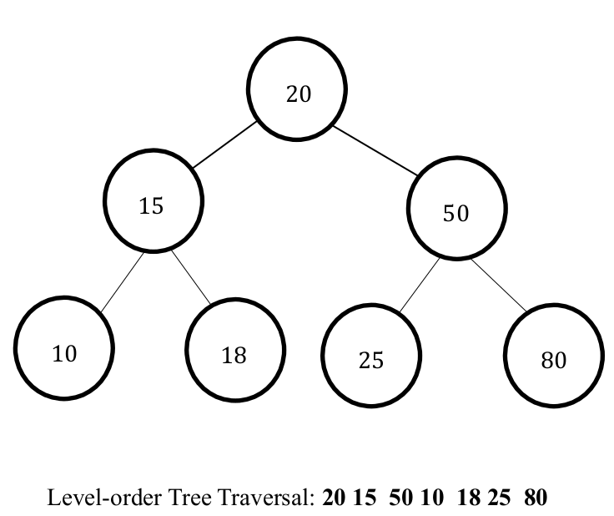
Question 2

Slide 19
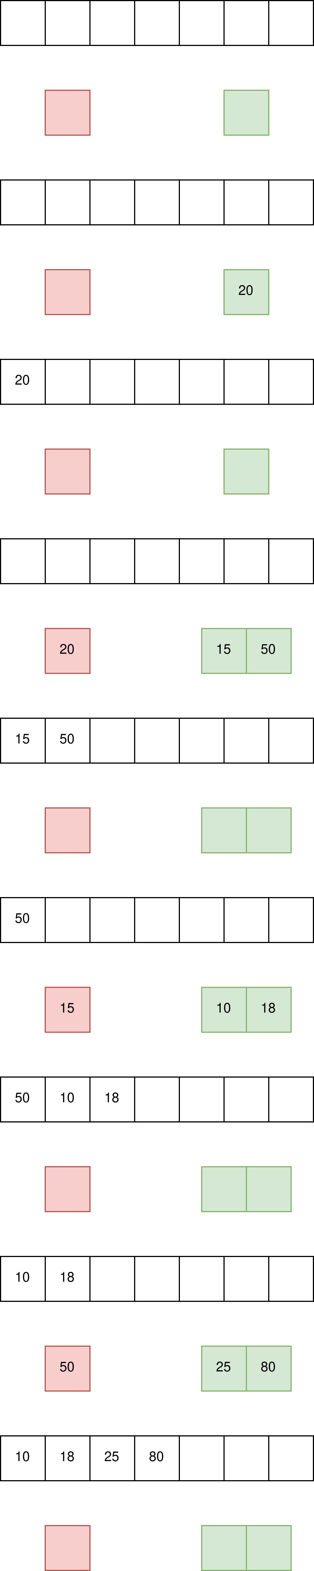
Question 2

Slide 20
Question 2

Slide 21
Question 2

Slide 22
Question 2

Slide 23
Question 2

Slide 24
Question 2

Slide 25
Question 2

Slide 26
Question 2

Slide 27
Question 2

Slide 28
Question 2
and so on

Slide 29
Question 2
def level_order_traversal(root):
queue = Queue()
temp = root
if temp is not None:
enqueue(queue, temp)
while not is_empty(queue.head):
temp = dequeue(q)
print(temp.item, end=' ')
if temp.left is not None:
enqueue(queue, temp.left)
if temp.right is not None:
enqueue(queue, temp.right)
del queue # Optional, as Python will automatically free this memory after a while

Slide 30
Question 3

Slide 31
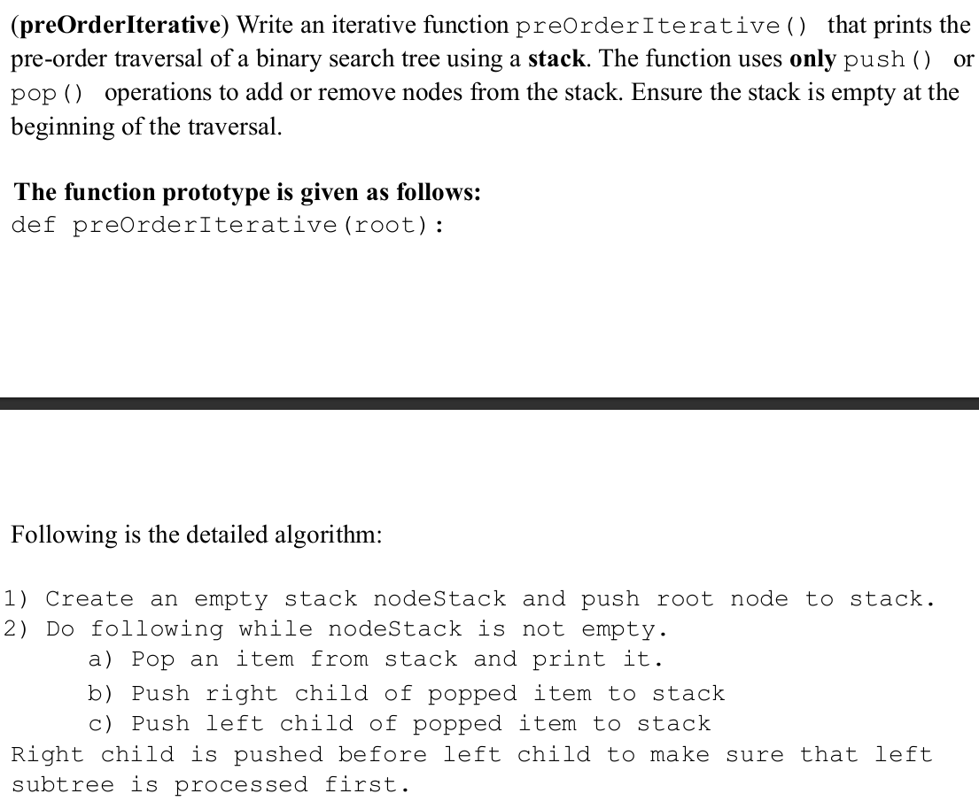
Question 3

Slide 32
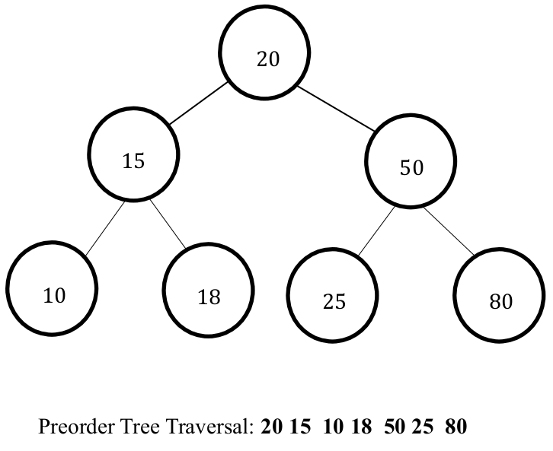
Question 3

Slide 33
Question 3

Slide 34
Question 3

Slide 35
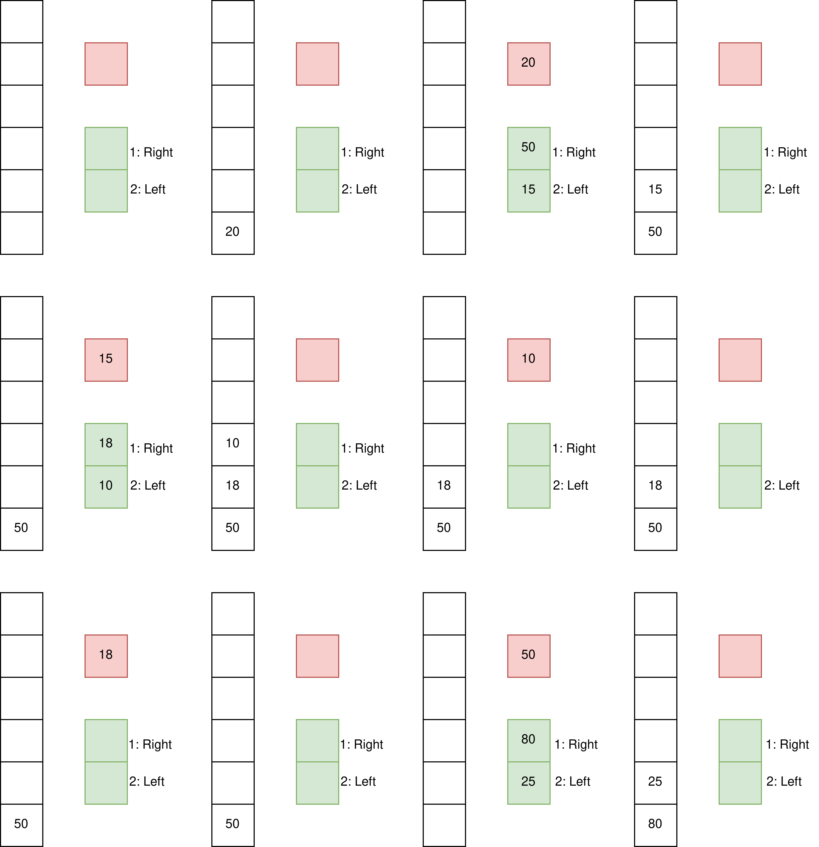
Question 3

Slide 36
Question 3

Slide 37
Question 3

Slide 38
Question 3

Slide 39
Question 3

Slide 40
Question 3

Slide 41
Question 3

Slide 42
Question 3

Slide 43
Question 3

Slide 44
Question 3

Slide 45
Question 3

Slide 46
Question 3

Slide 47
Question 3
def preOrderIterative(root):
stack = Stack()
temp = root
if temp is None:
return
push(stack, temp)
while not is_empty(stack):
temp = pop(stack)
print(temp.item, end=' ')
if temp.right is not None:
push(stack, temp.right)
if temp.left is not None:
push(stack, temp.left)
del stack # Optional, as Python will automatically free this memory after a while

Slide 48
Question 4

Slide 49
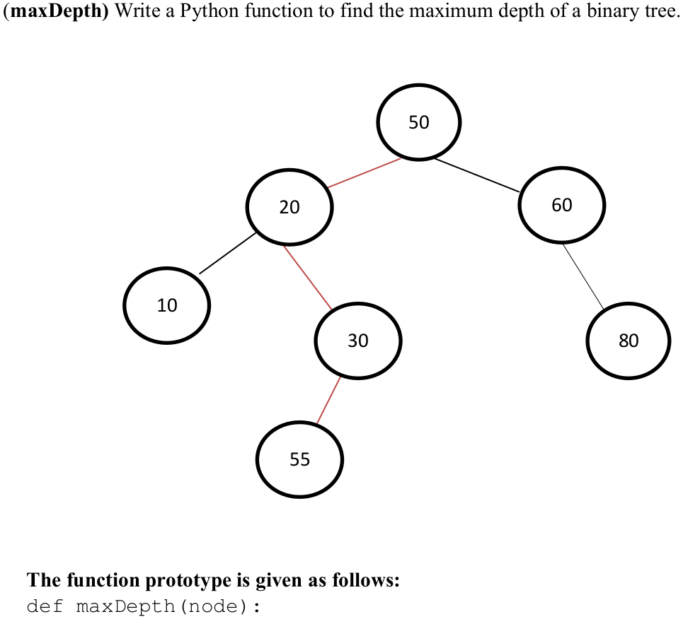
Question 4

Slide 50
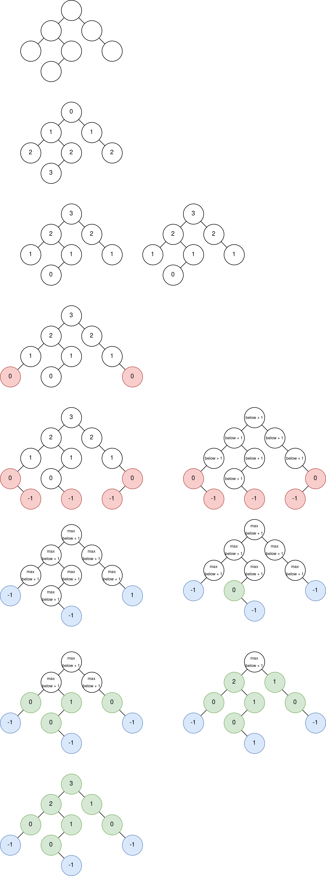
Question 4

Slide 51
Question 4

Slide 52
Question 4

Slide 53
Question 4

Slide 54
Question 4

Slide 55
Question 4

Slide 56
Question 4

Slide 57
Question 4

Slide 58
Question 4

Slide 59
Question 4

Slide 60
Question 4

Slide 61
Question 4
def maxDepth(node):
if node is None:
return -1
else:
ldepth = maxDepth(node.left)
rdepth = maxDepth(node.right)
if ldepth > rdepth:
return ldepth + 1
else:
return rdepth + 1

Slide 62
Slides and Source-code
Slides
https://nextcloud.broderlands.com/s/DcEMamAczQbkYxJ
Source code
https://git.broderlands.com/explore/repos

